Slide 1

BCSE307L – Compiler Design
Module 3 – Semantic Analysis

Slide 2
Contents
Syntax Directed Definition
Evaluation Order
Applications of Syntax Directed Translation
Syntax Directed Translation Schemes
Implementation of L-attributed Syntax Directed Definition.

Slide 3
Syntax-Directed Definitions
A generalization of context free grammar in which each grammar symbol has an associated set of attributes.
In SDT, every non-terminals can get zero or more attributes.
The attributes can be a number, type, memory location, return type etc.
Types of attributes are:
Synthesized attribute [Values can be evaluated from children]
  Ex: A → BC {A.val = fun(B.val, C. Val)}
Inherited attribute [Values can be evaluated from the parent or siblings]
  Ex: A → BC {B.val = A.val
  C.val = B.val}

Slide 4
Syntax Directed Translation Scheme
The Syntax directed translation scheme is a context free grammar
It is used to evaluate the order of semantic rules.
In translation scheme, the semantic rules are embedded within the right side of the production.
The position at which the action to be executed is enclosed between braces, { }.
  The position of a semantic action in a production body determines the order in which the action is executed.
  Ex: E → E₁ + T {print `+`}

Slide 5
1. Synthesized attributes
Value of synthesized attribute at a node can be computed from the value of attributes at the children of that node in the parse tree.
A syntax directed definition that uses synthesized attribute exclusively is said to be S-attribute definition.
Example: Syntax directed definition of simple desk calculator
Production | Semantic rules
L → E_{n} | Print (E.val)
E → E₁+T | E.val = E₁.val + T.val
E → T | E.val = T.val
T → T₁*F | T.val = T₁.val * F.val
T → F | T.val = F.val
F → (E) | F.val = E.val
F → digit | F.val = digit.lexval
an integer value returned by lexical
analyzer

Slide 6
Evaluating an SDD at the Nodes of a Parse Tree
The rules of an SDD are applied by first constructing a parse tree and then using the rules to evaluate all of the attributes at each of the nodes of the parse tree.
A parse tree, showing the value(s) of its attribute(s) is called an annotated parse tree.
Each of the nodes for the non-terminals has attribute, val computed in a bottom-up order

Slide 7
Example: Synthesized attributes
String: 3*5+4n;
Production | Semantic rules
L → E_{n} | Print (E.val)
E → E₁+T | E.Val = E₁.val + T.val
E → T | E.Val = T.val
T → T₁*F | T.Val = T₁.val * F.val
T → F | T.Val = F.val
F → (E) | F.Val = E.val
F → digit | F.Val = digit . lexval
L
n
E.val=19
+
T.val=4
E.val=15
The process of computing the attribute values at the node is called annotating or decorating the parse tree
T.val=15
F.val=4
*
digit.lexval=4
T.val=3
F.val=5
F.val=3
digit.lexval=5
parse tree showing the value of the attributes at each node is called Annotated parse tree
digit.lexval=3
Annotated parse tree for 3*5+4n

Slide 8
Example – synthesized and inherited attribute
Construct Annotated parse tree for 3 * 5

Slide 9
Exercise
Draw Annotated Parse tree for following using the SDD:
  (3+4)*(5+6)n
  1*2*3*(4+5)n
  (9+8*(7+6)+5)*4n
Production | Semantic rules
L → E_{n} | Print (E.val)
E → E₁+T | E.Val = E₁.val + T.val
E → T | E.Val = T.val
T → T₁*F | T.Val = T₁.val * F.val
T → F | T.Val = F.val
F → (E) | F.Val = E.val
F → digit | F.Val = digit . lexval

Slide 10
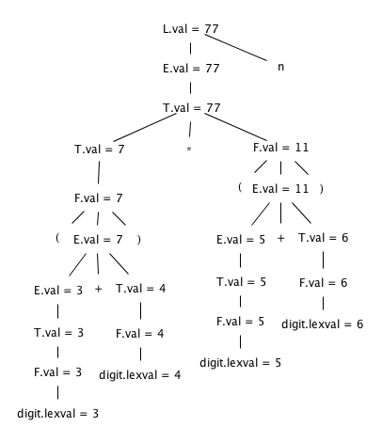
Solution1

Slide 11
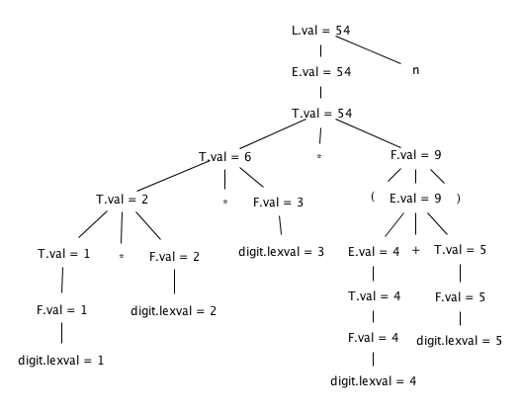
Solution2

Slide 12
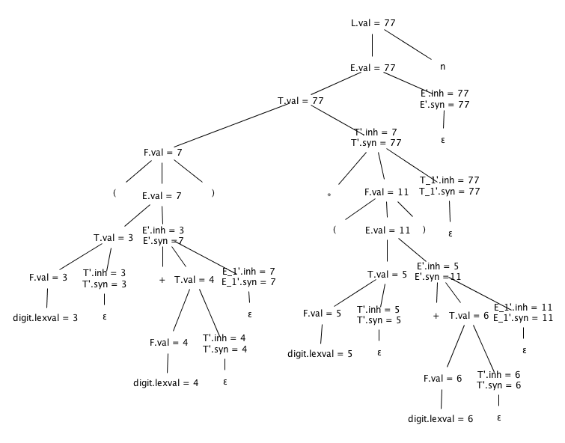
Solution3

Slide 13
Applications of SDT
Executing Arithmetic Expression
Conversion from Infix to Postfix
Conversion from Infix to Prefix
Conversion from Binary to Decimal
Counting No. of Reductions
Creating Syntax Tree
Generating Intermediate Code
Type Checking
Storing Type information into Symbol Table.

Slide 14
Syntax directed definition to translates arithmetic expressions
Infix to prefix notation
Production | Semantic rules
L→E | Print(E.val)
E→E+T | E.val=’+’ E.val T.val
E→E-T | E.val=’-‘ E.val T.val
E→T | E.val= T.val
T→T*F | T.val=’*’ T.val F.val
T→T/F | T.val=’/’ T.val F.val
T→F | T.val= F.val
F→F^P | F.val=’^’ F.val P.val
F→P | F.val= P.val
P→(E) | P.val= E.val
P→digit | P.val=digit.lexval

Slide 15
Inherited attribute
An inherited value at a node in a parse tree is computed from the value of attributes at the parent and/or siblings of the node.
Symbol T is associated with a synthesized attribute type.
Symbol L is associated with an inherited attribute in.
Production | Semantic rules
D → T L | L.in = T.type
T → int | T.type = integer
T → real | T.type = real
L → L₁ , id | L₁.in=L.in, addtype(id.entry,L.in)
L → id | addtype(id.entry,L.in)
a lexical value that points to a symbol-table object
the type being assigned to every identifier
Syntax directed definition with inherited attribute L.in

Slide 16
Example: Inherited attribute
Example: Pass data types to all identifier real id1,id2,id3
D
Production | Semantic rules
D → T L | L.in = T.type
T → int | T.type = integer
T → real | T.type = real
L → L₁ , id | L₁.in = L.in, addtype(id.entry,L.in)
L → id | addtype(id.entry,L.in)
L
T
L.in=real
T.type=real
real
,
id
L₁
id3
L.in=real
,
id2
L.in=real
id
L₁
id
id1
L → L₁ , id
L → id
D→TL

Slide 17
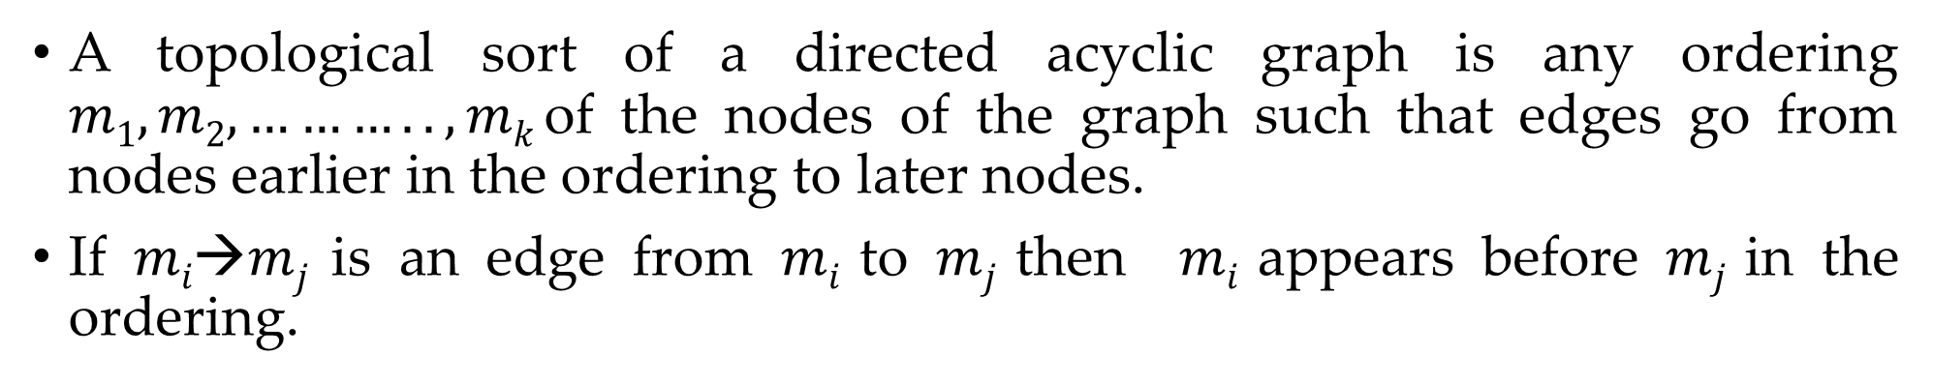
Evaluation order
A topological sort of a directed acyclic graph is any ordering $m1, m2,……….., mk$of the nodes of the graph such that edges go from nodes earlier in the ordering to later nodes.
If $mi→mj$is an edge from $mi$ to $mj$ then $mi$ appears before $mj$ in the ordering.
D
1
T.type=real
L.in=real
2
real
3
,
L.in=real
id3
4
,
id2
5
L.in=real
6
7
id1

Slide 18
Construction of syntax tree
Following functions are used to create the nodes of the syntax tree.
  Mknode (op,left,right): creates an operator node with label op and two fields containing pointers to left and right.
  Mkleaf (id, entry): creates an identifier node with label id and a field containing entry, a pointer to the symbol table entry for the identifier.
  Mkleaf (num, val): creates a number node with label num and a field containing val, the value of the number.

Slide 19
Construction of syntax tree for expressions
Example: construct syntax tree for a-4+c
P1: mkleaf(id, entry for a);
P2: mkleaf(num, 4);
P3: mknode(‘-‘,p1,p2);
P4: mkleaf(id, entry for c);
P5: mknode(‘+’,p3,p4);
P5
+
P3
-
P4
id
Entry for c
P1
id
P2
Num | 4
Entry for a

Slide 20
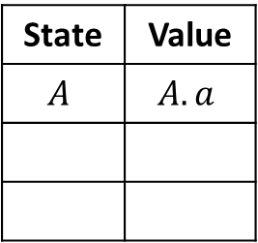
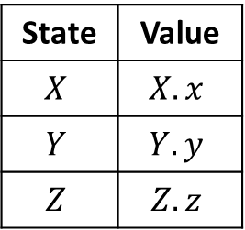
Bottom up evaluation of S-attributed definitions
S-attributed definition is one such class of syntax directed definition with synthesized attributes only.
Synthesized attributes can be evaluated using bottom up parser only.
Synthesized attributes on the parser stack
Consider the production A→XYZ and associated semantic action is A.a=f(X.x, Y.y, Z.z)
State | Value
$$X$$ | $$X.x$$
$$Y$$ | $$Y.y$$
$$Z$$ | $$Z.z$$
State | Value
$$A$$ | $$A.a$$
top-2
top
top-1
top
Before reduction
After reduction

Slide 21
Bottom up evaluation of S-attributed definitions
Production | Semantic rules
L → E_{n} | Print (val[top])
E → E₁+T | val[top]=val[top-2] + val[top]
E → T
T → T₁*F | val[top]=val[top-2] * val[top]
T → F
F → (E) | val[top]=val[top-2] - val[top]
F → digit
Input | State | Val | Production Used
3*5n | - | -
*5n | 3 | 3
*5n | F | 3 | F→digit
*5n | T | 3 | T→F
5n | T* | 3
n | T*5 | 3,5
n | T*F | 3,5 | F→digit
n | T | 15 | T→T₁*F
n | E | 15 | E→T
Implementation of a desk calculator with bottom up parser
 | En | 15
 | L | 15 | L → E_{n}
Move made by translator

Slide 22
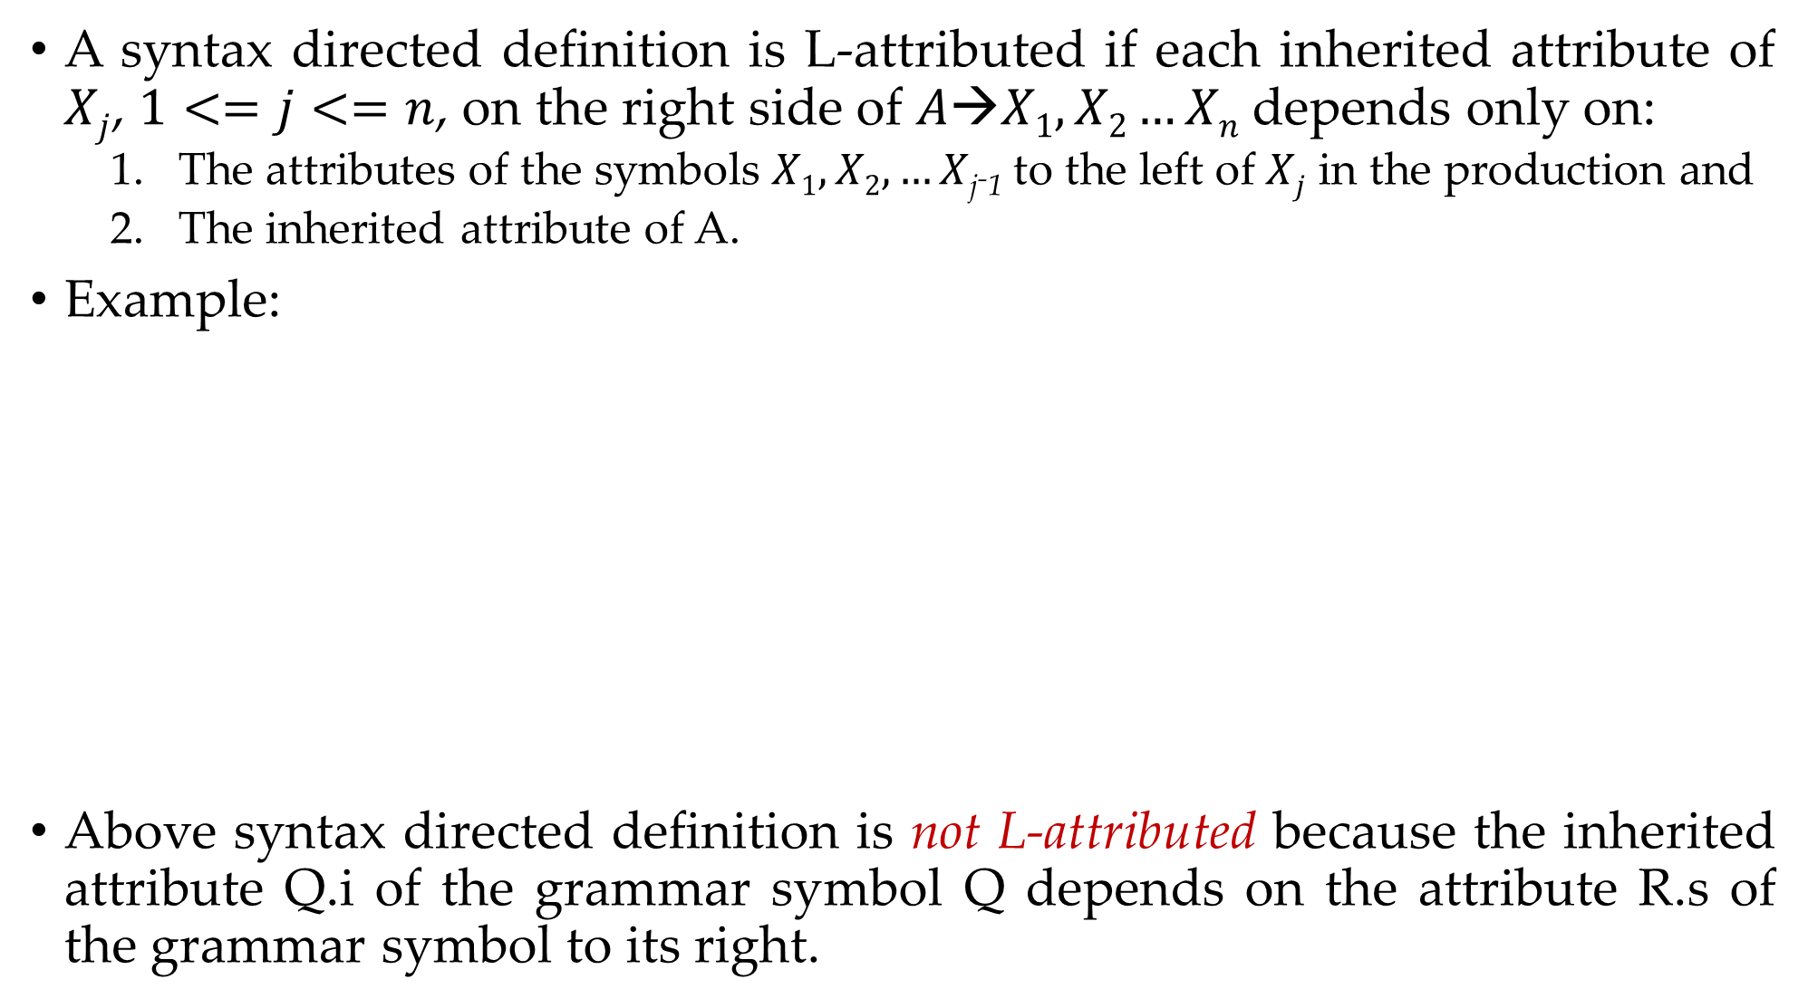
L-Attributed definitions
A syntax directed definition is L-attributed if each inherited attribute of $Xj$, $1<=j<=n$, on the right side of $A→X1,X2…Xn$depends only on:
  The attributes of the symbols $X1,X2,…X$_{j-1} to the left of $Xj$ in the production and
  The inherited attribute of A.
Example:
Above syntax directed definition is not L-attributed because the inherited attribute Q.i of the grammar symbol Q depends on the attribute R.s of the grammar symbol to its right.
Production | Semantic Rules
A→ LM | L.i:=l(A.i) M.i=m(L.s) A.s=f(M.s)
A→ QR | R.i=r(A.i) Q.i=q(R.s) A.s=f(Q.s)
A→XYZ
Not L- Attributed
L- Attributed

Slide 23
Bottom up evaluation of S-attributed definitions
Translation scheme is a context free grammar in which attributes are associated with the grammar symbols and semantic actions enclosed between braces { } are inserted within the right sides of productions.
Attributes are used to evaluate the expression along the process of parsing.
During the process of parsing the evaluation of attribute takes place by consulting the semantic action enclosed in { }.
A translation scheme generates the output by executing the semantic actions in an ordered manner.
This process uses the depth first traversal.

Slide 24
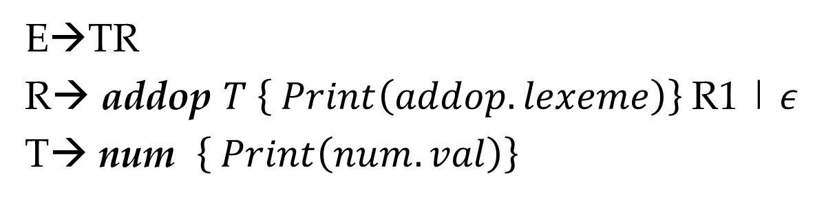
Example: Translation scheme (Infix to postfix notation)
String: 9-5+2
E→TR
R→ addop $T \left\{ Print\left(addop.lexeme\right)\right\}$R1 | 𝜖
T→ num $\left\{ Print\left(num.val\right)\right\}$
E
T
R
-
T
R
9
{Print(9)}
{Print(-)}
5
{Print(5)}
+
R
T
{Print(+)}
2
{Print(2)}
𝜖
Now, Perform Depth first traversal
Postfix=95-2+

Slide 25
Types of errors

Slide 26
Types of Errors
Errors
Compile time
Run time
Lexical Phase error
Syntactic Phase error
Semantic Phase error

Slide 27
Lexical error
Lexical errors can be detected during lexical analysis phase.
Typical lexical phase errors are:
Spelling errors
Exceeding length of identifier or numeric constants
Appearance of illegal characters
Example:
fi ( )
{
}
In above code 'fi' cannot be recognized as a misspelling of keyword if rather lexical analyzer will understand that it is an identifier and will return it as valid identifier.
Thus misspelling causes errors in token formation.

Slide 28
Syntax error
Syntax error appear during syntax analysis phase of compiler.
Typical syntax phase errors are:
Errors in structure
Missing operators
Unbalanced parenthesis
The parser demands for tokens from lexical analyzer and if the tokens do not satisfy the grammatical rules of programming language then the syntactical errors get raised.
Example:
printf(“Hello World !!!”)
Error: Semicolon missing

Slide 29
Semantic error
Semantic error detected during semantic analysis phase.
Typical semantic phase errors are:
Incompatible types of operands
Undeclared variable
Not matching of actual argument with formal argument
Example:
id1=id2+id3*60 (Note: id1, id2, id3 are real)
(Directly we can not perform multiplication due to incompatible types of variables)

Slide 30
Error recovery strategies
(Ad-Hoc & systematic methods)

Slide 31
Error recovery strategies (Ad-Hoc & systematic methods)
There are mainly four error recovery strategies:
Panic mode
Phrase level recovery
Error production
Global generation

Slide 32
Panic mode
In this method on discovering error, the parser discards input symbol one at a time. This process is continued until one of a designated set of synchronizing tokens is found.
Synchronizing tokens are delimiters such as semicolon or end.
These tokens indicate an end of the statement.
If there is less number of errors in the same statement then this strategy is best choice.
fi ( )
{
}
Scan entire line otherwise scanner will return fi as valid identifier

Slide 33
Phrase level recovery
In this method, on discovering an error parser performs local correction on remaining input.
The local correction can be replacing comma by semicolon, deletion of semicolons or inserting missing semicolon.
This type of local correction is decided by compiler designer.
This method is used in many error-repairing compilers.

Slide 34
Error production
If we have good knowledge of common errors that might be encountered, then we can augment the grammar for the corresponding language with error productions that generate the erroneous constructs.
Then we use the grammar augmented by these error production to construct a parser.
If error production is used then, during parsing we can generate appropriate error message and parsing can be continued.

Slide 35
Global correction
Given an incorrect input string x and grammar G, the algorithm will find a parse tree for a related string y, such that number of insertions, deletions and changes of token require to transform x into y is as small as possible.
Such methods increase time and space requirements at parsing time.
Global correction is thus simply a theoretical concept.

